Slide 1


Modulating synaptic plasticity with weak electric fields
Greg Kronberg
The City College of New York, Biomedical Engineering

Slide 2
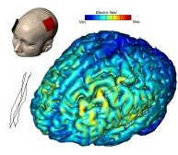
Transcranial electrical stimulation
2 mA at scalp
1 V/m in cortex
~20 minutes/session
Online and lasting cognitive enhancements:
Declarative memory
Motor skill acquisition
Verbal fluency
Depression symptoms
Appetite control
How do weak electric fields alter neuronal information processing?
Notes:
tDCS is a neuromodulatory technique that’s gained a lot attention recently for its potential benefits
The general paradigm is to place electrodes on the scalp and apply a weak constant electric current for an extended period of time (typically up to 2 mA for 20 min)
This has been found to be effective at treating a variety disorders and enhancing basic cognitive functions. I will be focusing in particular on the effects of tDCS on learning and memory

Slide 3
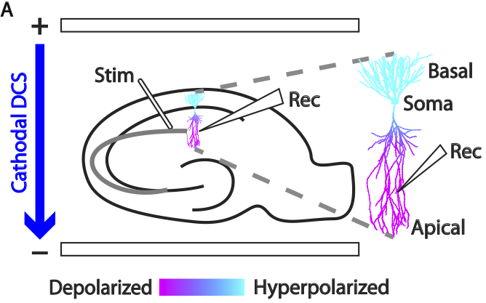
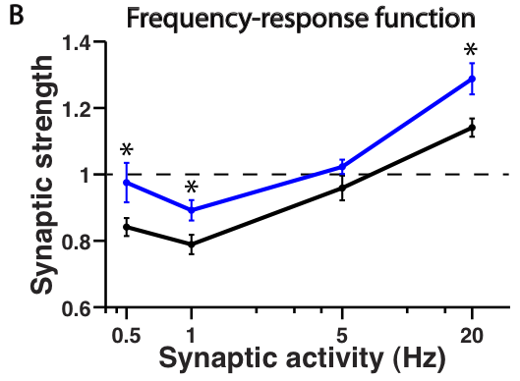
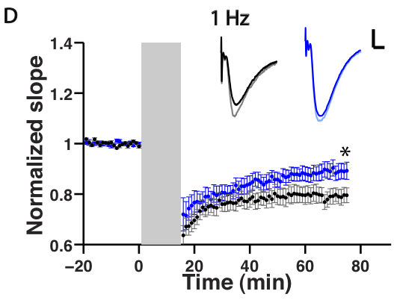
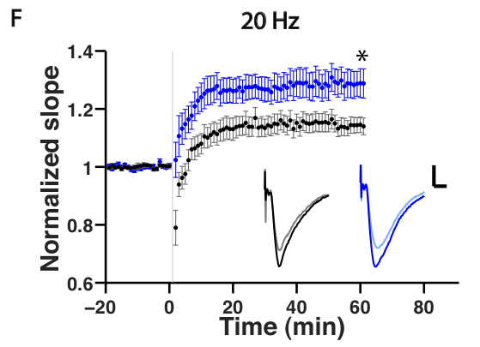


DC stimulation and synaptic plasticity in vitro
Kronberg et al., Brain Stim 2016
Notes:
Here is a cartoon of a hippocampal slice, and now we can place electrodes across the slice and apply DCS during plasticity induction
So here we are plotted the normalized EPSP slope over time, this can be thought of as relative synaptic strength. We can record a stable baseline and then activate synapses at a low frequency to induce depression or LTD. This is the black curve (control). Now if we apply DCS during induction (gray bar), the LTD is reduced or the synapses remain stronger
We can repeat the same paradigm for 20 Hz and see that LTP is enhanced when DCS is applied
WE can repeat this across a range of frequencies to generate a frequency response function
This maps the degree of synaptic activity during induction to the resulting amount of synaptic plasticity
So the horizontal axis is how much these neurons are firing together and the vertical axis is how they change their wire in response
We notice that for any given activity DCS biases these synapses towards increased strength

Slide 4
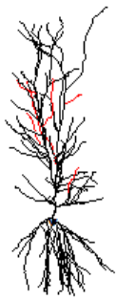
Modeling DC stimulation and synaptic integration
Detailed CA1 pyramidal neuron with HH biophysics
Based on Migliore et al. 2005 J. NeuroPhys
NEURON as Python module
Synaptic
Input
DC electric field

Slide 5
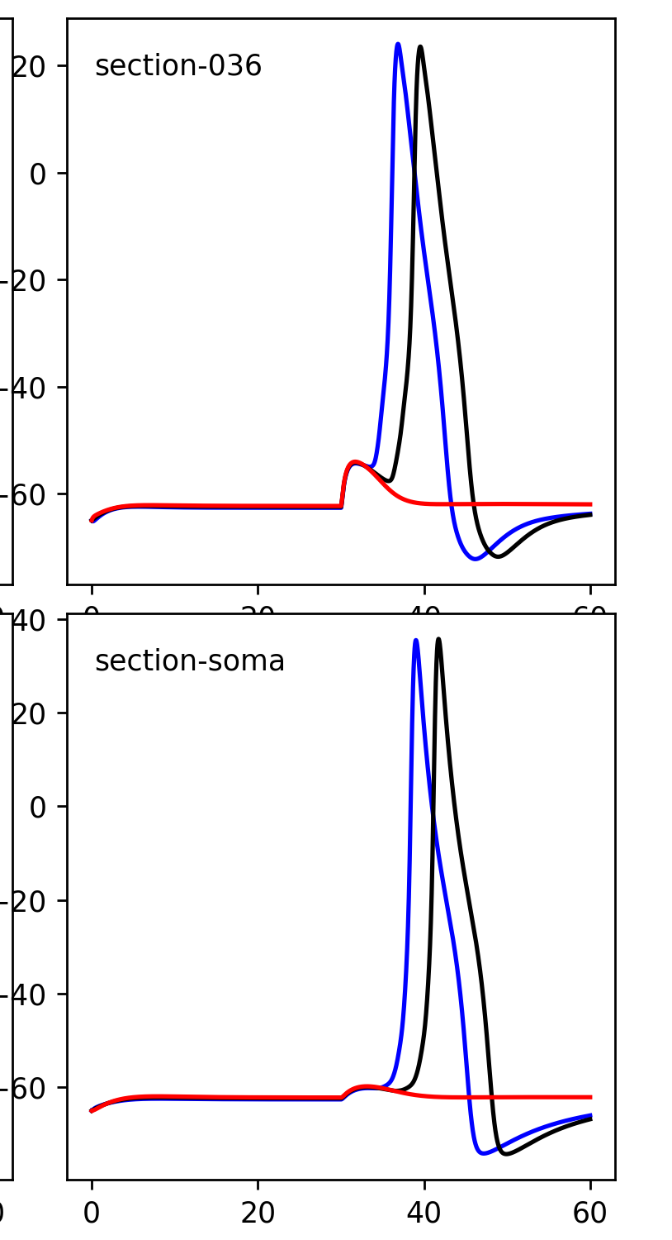
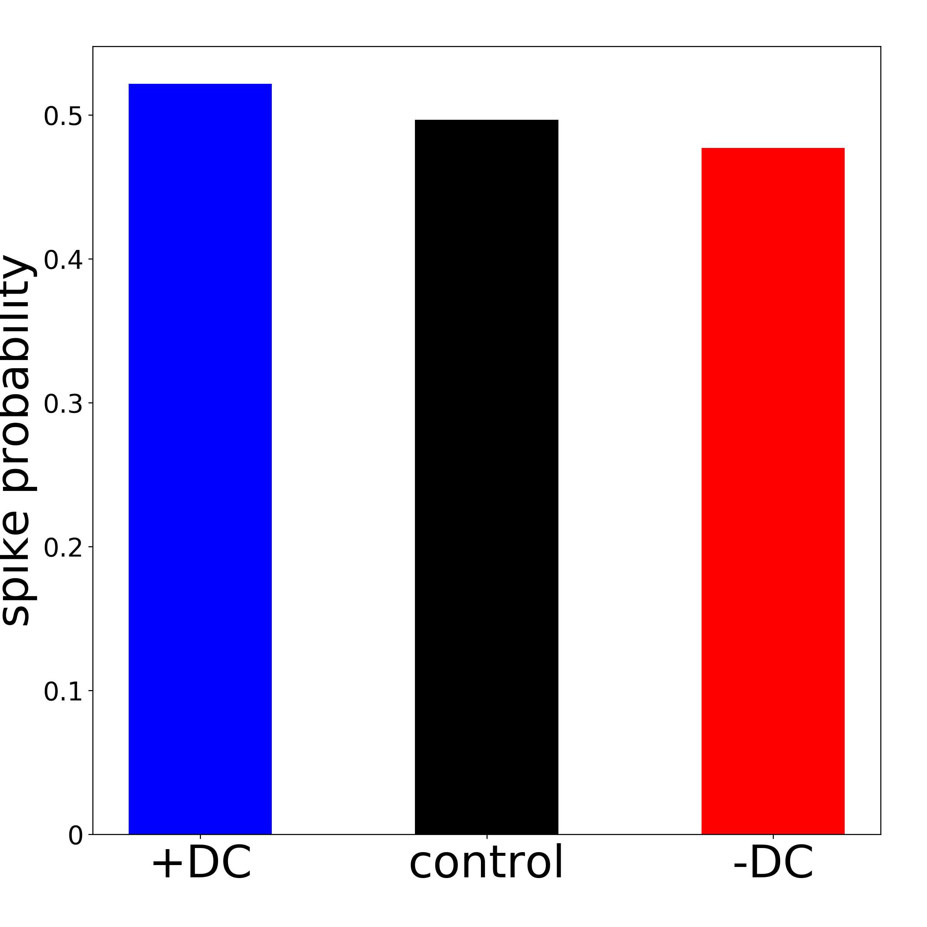
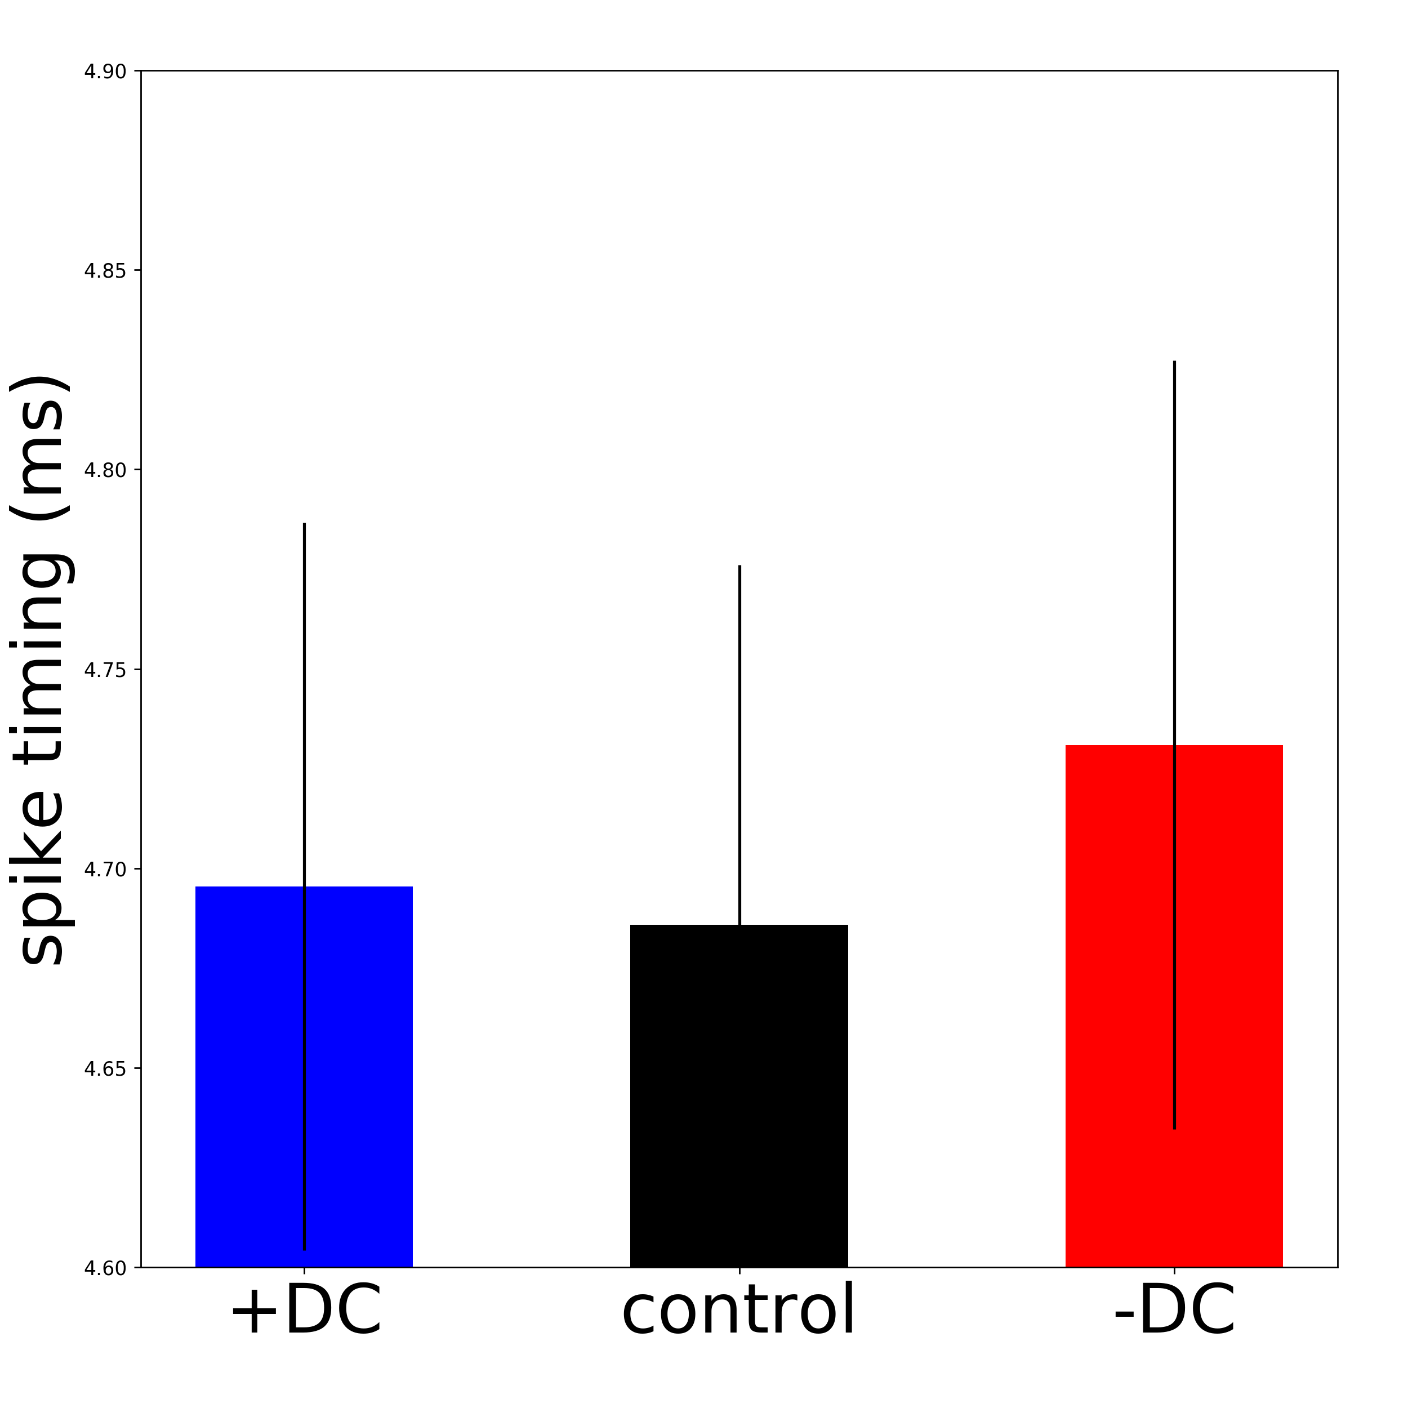
Modeling DC stimulation and synaptic integration
_{Synaptic}
_{Input}
_{DC electric field}

Slide 6
Future Work
Incorporate voltage-based plasticity rule
Fit to experimental data
Reduce to two compartment model?

